Slide 1

Unit 14 I remember meeting all of you in Grade 7.

Slide 2


Slide 3

Ⅰ. 根据句意，从方框中选择恰当的单词填空，
有的需要变换形式。
keyboard, double, caring, method, our, instruction, standard, overcome
1. The coach often gives us clear ___________
on what to do next during our training.
2. I've always thought of Joe as a very
_______ person. He is very warm-hearted.
3. The price of vegetables has been _______
because of bad weather.
instructions
caring
doubled

Slide 4
keyboard, double, caring, method, our, instruction, standard, overcome
4. If you don't have a tent, you can borrow
_______. We have two.
5. From the report, we know that traditional
teaching _______ are still used in poor
villages.
6. It's believed that a number of Britain's
beaches fail to meet European _________
on cleanliness.
ours
methods
standards

Slide 5
keyboard, double, caring, method, our, instruction, standard, overcome
7. When he acted in the play, he tried his
best to ___________ his shyness.
8. My cousin is playing a song on his
__________. It sounds beautiful.
overcome
keyboard

Slide 6
Ⅱ. 根据汉语意思完成英语句子，每空一词。
1. 为了把这项工作做得更好，你得付出更多
的努力。
In order to do the job better, you have to
_______ _______ _______ _______.
2. 我们正在做一项有关司机对警察持什么态
度的调查。
We are _______ _______ _______ on
drivers' attitudes to the police.
put in more effort
doing a survey

Slide 7
3. 他做饭的时候总是把厨房弄得一团糟。
He always _______ _______ _______ in the
kitchen when he is cooking.
4. 作为老师，我们应该对学生有耐心。
As teachers, we should _______ _______
_______ students.
5. 刚才她把那件事又向我解释了一遍。
Just now she _________ the matter _______
_______ again.
makes a mess
be patient
with
explained to me

Slide 8
6. 当我回忆那些日子时，我真的很不高兴。
When I _______ _______ _______ those
days, I am really unhappy.
7. 当他连续进了两个球时，我们都兴奋得跳
了起来。
When he scored two goals _______ _______
_______, we all jumped with excitement.
8. 在那么艰难的形势下，她依然保持冷静。
She _______ _______ _______ in such a
difficult situation.
look back at
in a row
kept her cool

Slide 9


Slide 10

Ⅰ. 根据语境，用括号内所给动词的正确时
态填空。
1. —A nice scarf! A present?
—Yes, it is. My cousin _______(send) it to
me for my 12th birthday.
2. We all know robots _______(do) more
heavy work for us in the future.
3. Alice, you are already in the office. When
_______ you _______(come)?
sent
will do
did come

Slide 11
4. —Hi, Lily. Where are you hurrying to?
—To the museum. My classmates
__________(wait) for me there.
5. Yuntai Mount is wonderful. _______ you
ever _______(visit) it?
6. Paul has left for Beijing. He _______(give)
a speech there tomorrow.
are waiting
Have
visited
will give

Slide 12
7. —I'm surprised at the new look of our city,
Jenny.
—Yeah. It ____________(change) a lot. It's
more beautiful than before.
8. —Why are there so many people in the
store?
—Because some clothes are really at a low
price. They __________(buy) clothes on
sale.
has changed
are buying

Slide 13
Ⅱ. 将下列句子合并为含有宾语从句的复合句。
1. When will Kate visit our farm? Can you tell
me?
_____________________________________
_____________________________________
2. Has Mr. Liu gone to the teaching building?
Do you know?
_____________________________________
_____________________________________
Can you tell me when Kate will visit our farm?
Do you know if / whether Mr. Liu has gone to the teaching building?

Slide 14
3. How does Mary usually go to work? Mary's
friend wants to know.
_____________________________________
_____________________________________
4. When did our teacher stand at the door?
Please tell me.
_____________________________________
_____________________________________
Mary's friend wants to know how Mary usually goes to work.
Please tell me when our teacher stood at the door.

Slide 15
5. The earth travels around the sun. My
father said.
_____________________________________
_____________________________________
My father said the earth travels around the sun.

Slide 16
Ⅲ. 根据短文内容及括号内所给动词的提示填
空。
On Saturday morning, every boy in town was happy, except Tom. His aunt said he (1)_______(have) to paint the fence (围栏). It was thirty yards long and three yards high! When Tom was working, some boys came and (2)_______(make) fun of him.
had
made

Slide 17
Ben was the first one who came happily with an apple in his hand.
“I (3)_______(go) swimming,” said Ben. “Do you want to come? Oh, you have to work, don't you?”
Tom got a little angry, but soon he had a wonderful idea.
“Work? ” he said. “I don't think this is work. It's fun.”
will go

Slide 18
Ben was watching Tom's every move and was getting more and more interested.
Then he said, “Tom, _______ you (4)_______(let) me do some painting? ”
“No way. You see. My aunt (5)_______(want) it to be done properly. I'm the only one that can do it right. ”
“Oh, please, Tom,” said Ben. “I (6)_______ (be) really careful. Let me try! I (7)_______ (give) you my apple in return.”
will
let
wants
will be
will give

Slide 19
“All right,” said Tom. “But you must be careful.”
He gave Ben his brush with worry on his face but joy in his heart. He (8)_______(start) to eat Ben's apple.
All day, boys (9)_______(pass) by and wanted to paint. When Ben got tired, Billy began to paint. He gave Tom his favorite kite. Then Johnny (10)_______(do) and so on.
started
passed
did

Slide 20
That afternoon, Tom got many things, and the fence got three coats of paint. His aunt was pleased with (对……满意) him!

Slide 21


Slide 22
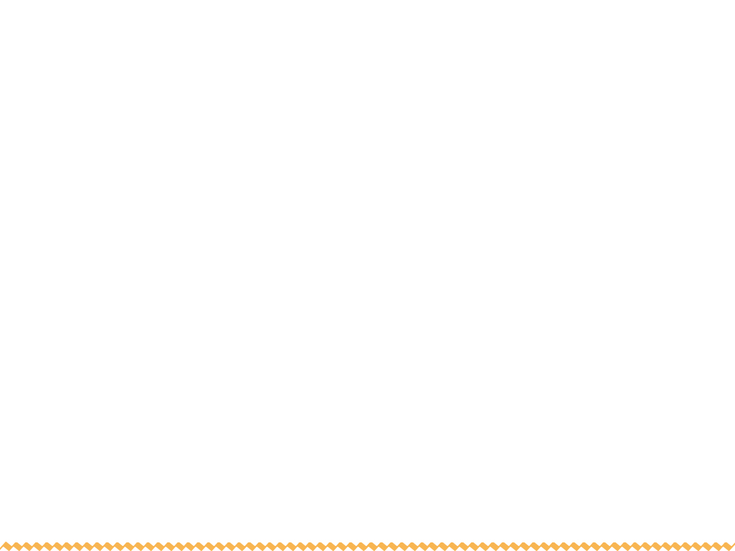
Ⅰ. 根据句意，从方框中选择恰当的单词填
空，有的需要变换形式。
task, manager, congratulate, degree, gentleman, wing, separate
1. The bird couldn't fly because both of its
_______ were broken.
2. Our teacher _____________ us all on our
results at the meeting.
wings
congratulated

Slide 23
task, manager, congratulate, degree, gentleman, wing, separate
gentlemen
3. The three _________ who are wearing ties
are standing there. Who are they?
4. The job requires a high _______ of skill, so
you must work hard for it.
5. My father is in control of the hotel. He is
the hotel _________.
degree
manager

Slide 24
task, manager, congratulate, degree, gentleman, wing, separate
6. She felt sorry that she didn't complete the
_______ that the leader gave her.
7. England is _________ from France by the
Channel (英吉利海峡).
task(s)
separated

Slide 25
Ⅱ. 根据汉语意思完成英语句子，每空一词。
1. 要开车，首先你得通过驾照考试。
To drive the car, _______ _______ _______,
you have to pass the driving test.
2. 请信任我，我一定会按时还钱的。
Please _______ _______ me. I am sure to
give the money back to you on time.
first of all
believe in

Slide 26
3. 去年毕业后，她渴望有一份好工作。
After graduation last year, she _______
_______ _______ a good job.
4. 我们必须努力，因为我们面临着许多困难。
We must work hard because we have
many difficulties _______ _______ us.
5. 他们昨天开始了旅行的最后一程。
Yesterday they _______ _______ on the
last stage of their journey.
was
thirsty for
ahead of
set out

Slide 27
6. 我对老师们心存感激，因为我从他们那里
学到了很多知识。
I _______ _______ _______ my teachers
because I have learned lots of knowledge
from them.
7. 你知道谁为那次重大错误负责了？
Do you know who _____ ___________ _____
that big mistake?
am thankful to
was responsible for

Slide 28
8. Mrs. Green连同她的两个孩子都逃离了那
场大火。
Mrs. Green ran away from the big fire
_______ _______ her two children.
along with

Slide 29


Slide 30

根据短文内容，从方框中选择恰当的词语填空，有的需要变换形式。
be thankful to, instruction, forever, task, look back at, gentleman, congratulate, make a mess, caring, overcome
Hi, I'm Kevin. When I (1)____________ the past, I regret some things that I did. When I was in Grade Seven, I couldn't always follow the rules.
look back at

Slide 31
be thankful to, instruction, forever, task, look back at, gentleman, congratulate, make a mess, caring, overcome
I didn't follow my teachers' (2)___________. I didn't complete the (3)_______ on time that teachers gave. I (4)____________ in the classroom. I played tricks on schoolmates. I often hid their textbooks somewhere. So I was often asked to see the head teacher.
instructions
tasks
made a mess

Slide 32
be thankful to, instruction, forever, task, look back at, gentleman, congratulate, make a mess, caring, overcome
Mr. Ratcliff, the head teacher was a kind (5)__________. But when he spanked (打……的屁股) me for putting some ants into a classmate's pencil box, I didn't think so.
When I was called to Mr. Ratcliff 's office for the sixth time, I had no idea what I had done. I felt nervous. Then I heard Mr.
gentleman

Slide 33
be thankful to, instruction, forever, task, look back at, gentleman, congratulate, make a mess, caring, overcome
Ratcliff say, “Kevin, you have been behaving well lately. I'm proud of you. I'm sure you've already (6)_________ your problems. I should (7)___________ you! I just called you to my office to give you a peppermint (薄荷糖).”
overcome
congratulate

Slide 34
be thankful to, instruction, forever, task, look back at, gentleman, congratulate, make a mess, caring, overcome
“Really?” I was surprised.
“Yes. Take that peppermint and go back to class.”
Since then I've behaved well. And I've become a more (8)_______ boy.
caring

Slide 35
be thankful to, instruction, forever, task, look back at, gentleman, congratulate, make a mess, caring, overcome
Mr. Ratcliff gave me hope by giving me some love. I (9)________________ him. Although we are not together, I will remember him (10)_______. Mr. Ratcliff was really kind to me. I want to be just like him.
was thankful to
forever

